Slide 1
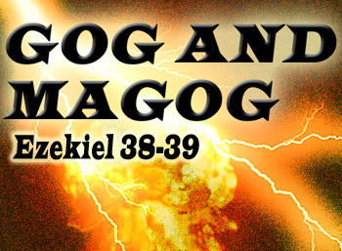

Slide 2
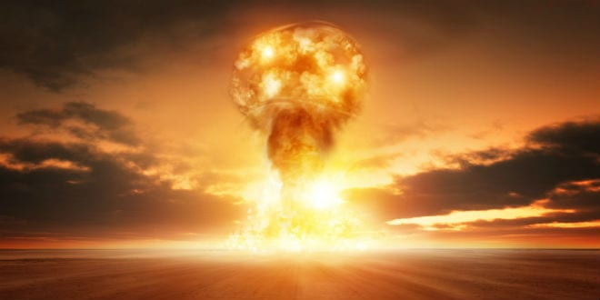

Slide 3
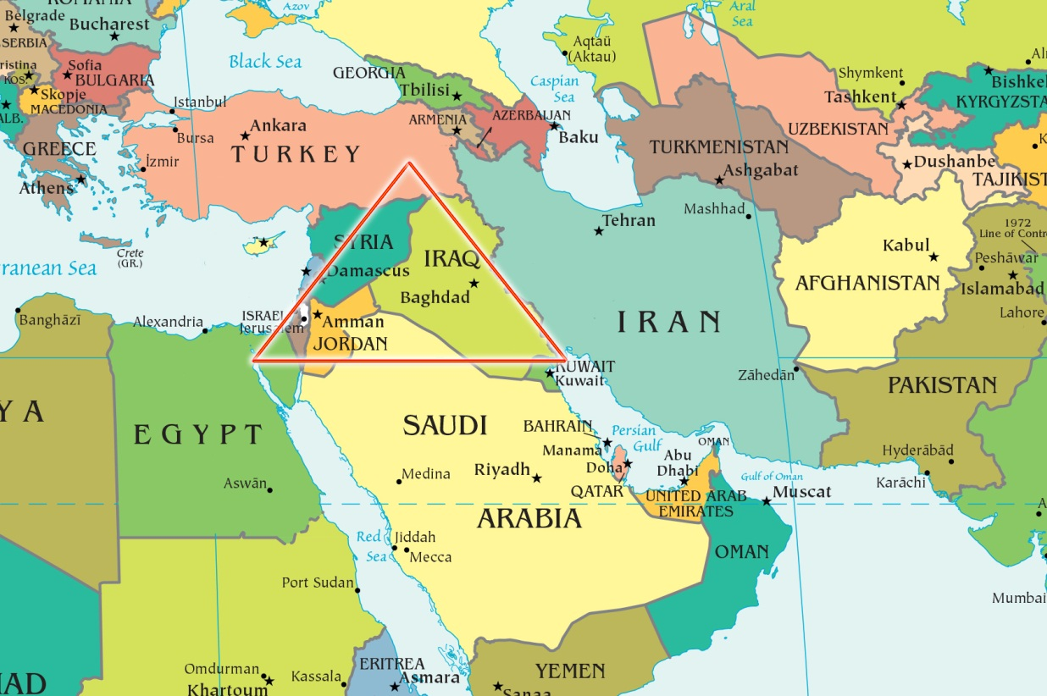
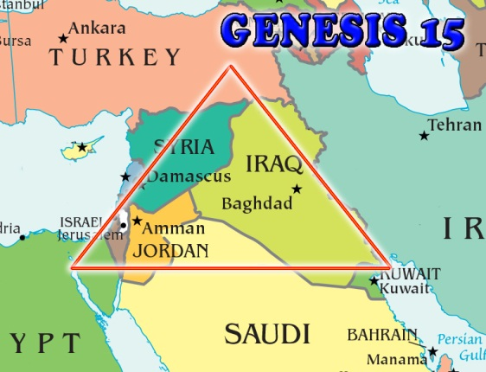
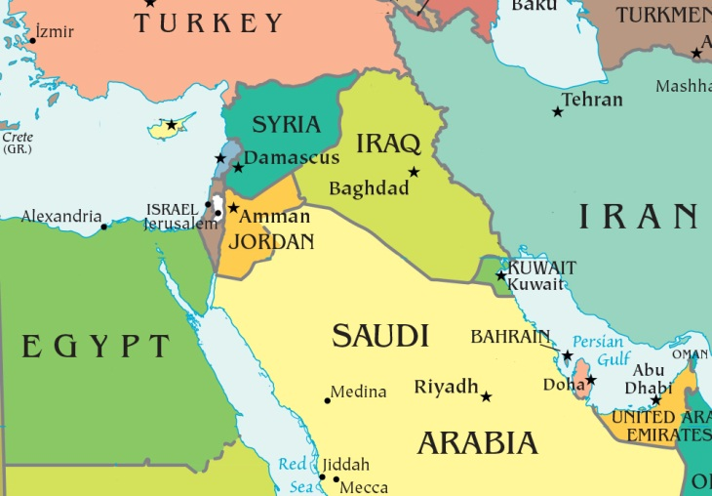
Middle East Prophecy Texts
Psalm 83 – Nations coming against Israel
Isaiah 17 – Destruction of Damascus (Syria)
Daniel 11:40-45 – Kings of North and South
Ezekiel 25 and 35 – Destruction of Edom (Esau)
Notes:
The triangle is the original land grant given to Abraham by God in Genesis 15

Slide 4
History of the Arab Nations

Slide 5
Middle East Prophecy Texts
Psalm 83 – Nations coming against Israel
Isaiah 17 – Destruction of Damascus (Syria)
Daniel 11:40-45 – Kings of North and South
Ezekiel 25 and 35 – Destruction of Edom (Esau)
Ezekiel 36-37 – Restoration of Israel
Ezekiel 38-39 – a combined Muslim fundamentalist confederacy that might include Russia

Slide 6
Purpose of Learning Ezekiel 38-39
Shows destruction of Islam/Muslim military might.
God is against the Muslim religion and Muslim nations as God destroys their armies when they invade Israel.
The Bible is proven true as it correctly predicts many aspects of modern world politics.
The destruction of Muslim nations opens the way the Antichrist to become the major world power in the Tribulation period.

Slide 7
Ezekiel 36 – God Restoring Israel
Ezekiel 36:24-38 - 4 steps
For I will take you from among the heathen, and gather you out of all countries, and will bring you into your own land.

Slide 8
Ezekiel 37
Israel’s National Resurrection
Ezekiel 37:1-4 The hand of the LORD was upon me, and carried me out in the spirit of the LORD, and set me down in the midst of the valley which was full of bones,
2 And caused me to pass by them round about: and, behold, there were very many in the open valley; and, lo, they were very dry.
3 And he said unto me, Son of man, can these bones live? And I answered, O Lord GOD, thou knowest.
4 Again he said unto me, Prophesy upon these bones, and say unto them, O ye dry bones, hear the word of the LORD.

Slide 9
Ezekiel 37
Israel’s National Resurrection
The Skeleton Stage -
Ezekiel 37:7 … and as I prophesied, there was a noise, and behold a shaking, and the bones came together, bone to his bone.
Chaim Weizman’s improved the method of making explosives, thus giving Britain a greater fire power advantage in World War I.
In appreciation the Balfour Declaration in 1917 AD was passed by the British Government promising Palestine as a national home for the Jews.

Slide 10
Ezekiel 37
Israel’s National Resurrection
The Sinews, Flesh and Skin -
Ezekiel 37:8 And when I beheld, lo, the sinews and the flesh came up upon them, and the skin covered them …
The establishment of Israel as a nation in Palestine in 1948, by a United Nations mandate.
On June 5, 1967, 185,000 troops moved in war on Israel. The Israeli air force destroyed 400 Russian built, Arab war planes on the ground in one day. Israel captured Jerusalem and the Golan Heights in what became known as the Six Day War.
On October 6, 1973, the Yom Kippur War – Arabs attacked Israel with much modern Russian weaponry.
In 1990, Russia permitted 750,000 Jews to emigrate to Israel.

Slide 11
Ezekiel 37
Israel’s National Resurrection
BREATH stage -
Ezekiel 37:10 So I prophesied as he commanded me, and the breath came into them, and they lived, and stood up upon their feet, an exceeding great army.
National restored Israel receiving the Holy Spirit as promised in Israel’s New Covenant (36:24-28). This occurs after Armageddon when Christ returns to rescue them from destruction by the Antichrist. This prophecy will be ultimately fulfilled when Christ regathers believing Israelites to Israel in the Millennium. See Jeremiah 31:31-34.
Breath Stage

Slide 12
Ezekiel 37
Israel’s National Resurrection
TWO STICKS – Ezekiel 37:15-22
Judah (Southern Kingdom)
Ephraim (Northern Kingdom)
God restores His people Israel to the land and reunites them as a single nation in the land.

Slide 13
Ezekiel 38
Fundamental Muslim Invasion
3 year mark
Ezekiel 38:1-3 And the word of the LORD came unto me, saying,
2 Son of man, set thy face against Gog, the land of Magog, the chief prince of Meshech and Tubal, and prophesy against him,
3 And say, Thus saith the Lord GOD; Behold, I am against thee, O Gog, the chief prince of Meshech and Tubal:
Notes:
This is not the battle of Armageddon because Israel is dwelling safely at this time
This battle ends in a hailstorm of fire and brimstone
The battle of Armageddon ends with the Lord slaying the armies of the Muslim antichrist with the sword that proceeds from His mouth in Revelation 19

Slide 14
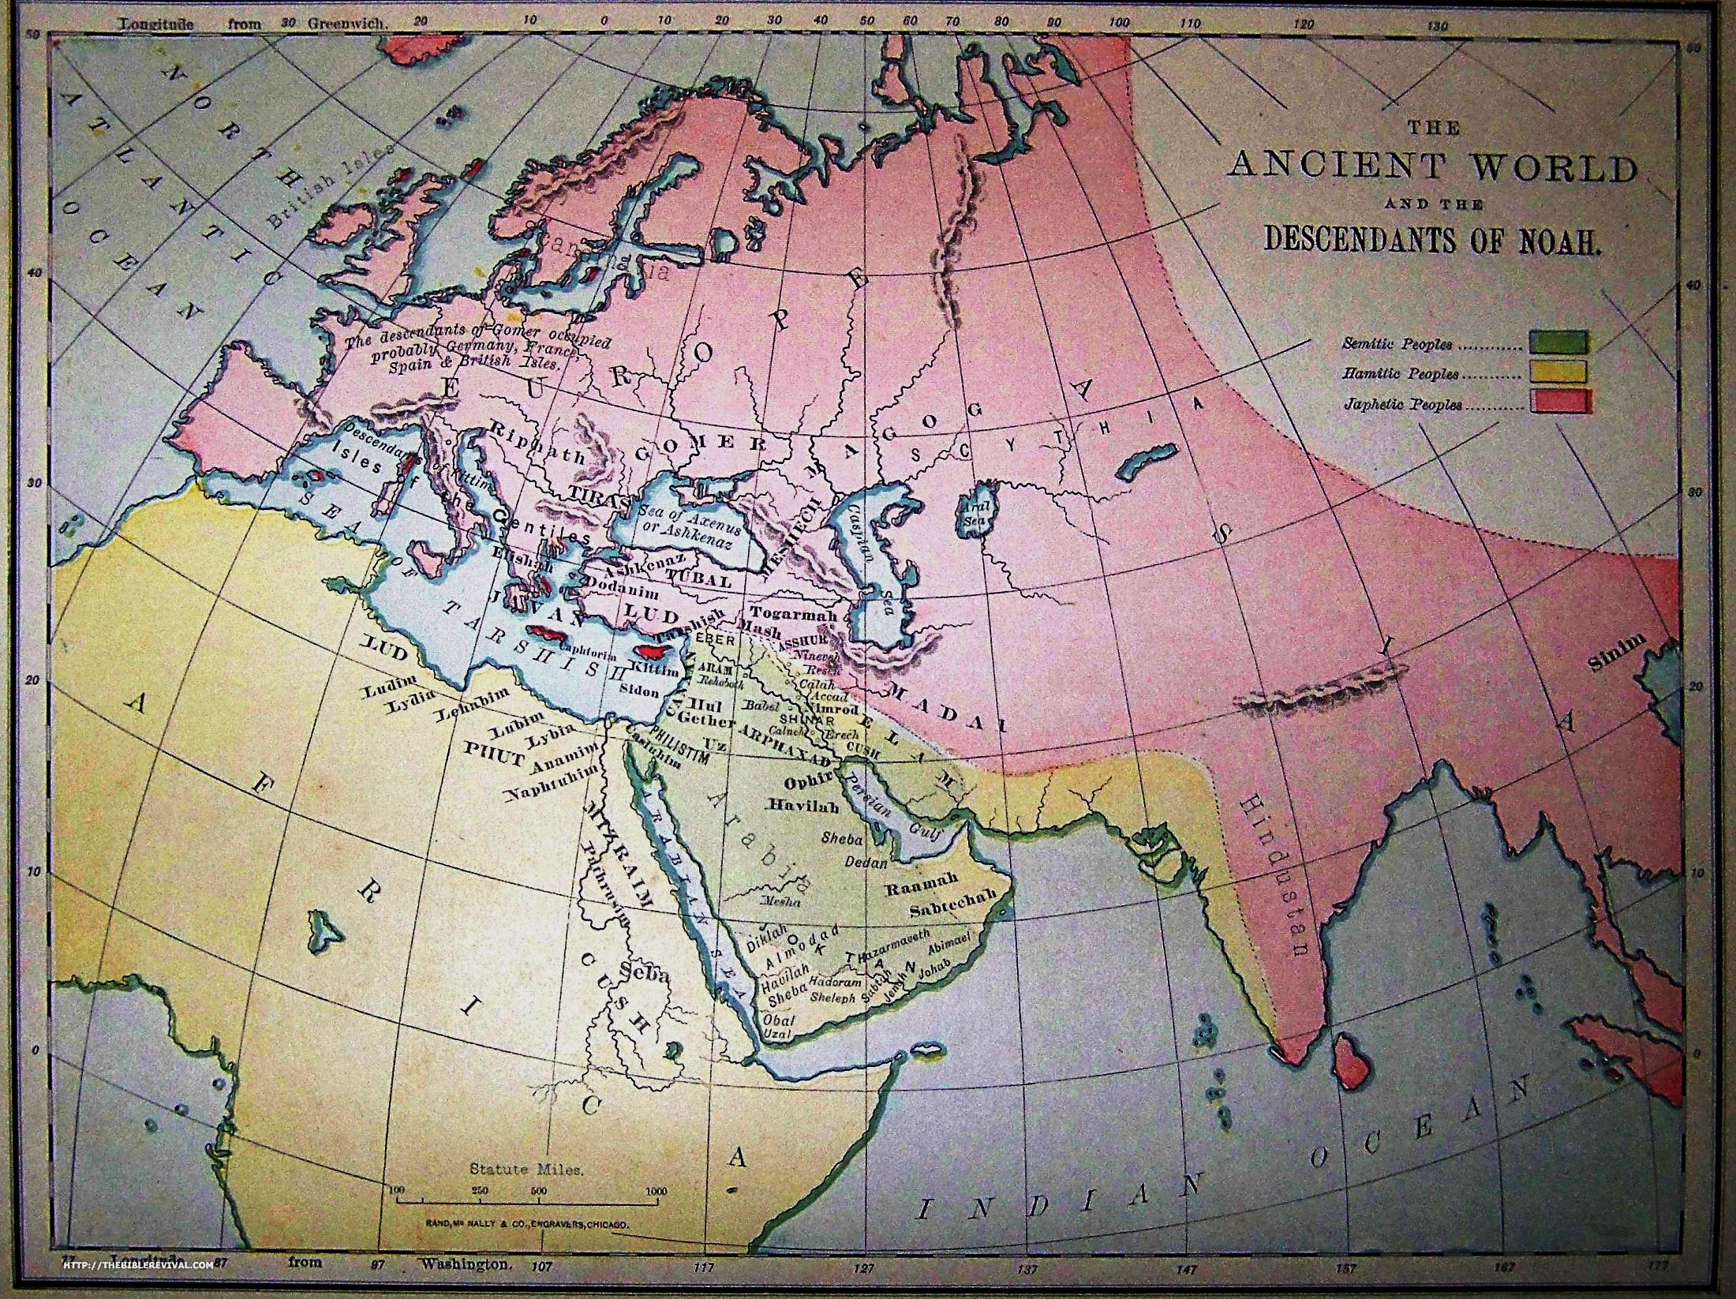
Ezekiel 38
Russian led Muslim Invasion
Japheth
Who is Gog and Where is Magog?
Genesis 10:2-5 The sons of Japheth; Gomer, and Magog, and Madai, and Javan, and Tubal, and Meshech, and Tiras.
3 And the sons of Gomer; Ashkenaz, and Riphath, and Togarmah.
4 And the sons of Javan; Elishah, and Tarshish, Kittim, and Dodanim.
5 By these were the isles of the Gentiles divided in their lands; every one after his tongue, after their families, in their nations.
Ham
Shem
Notes:
What is traditionally taught is that Gog and Magog are Russia This cannot be because of where they originated

Slide 15
Ezekiel 38 and 39
Psalm 83 and Daniel 11:40-45
Fundamental Muslim Federation Invasion
Gog
Magog
Meshech
Tubal
Persia
Ethiopia(Cush
Lybia (Put)
8. Gomer
Togarmah
King of the North
King of the South
Ishmaelites or Edom
Tyre
Sheba and Dedan
Merchants of Tarshish

Slide 16
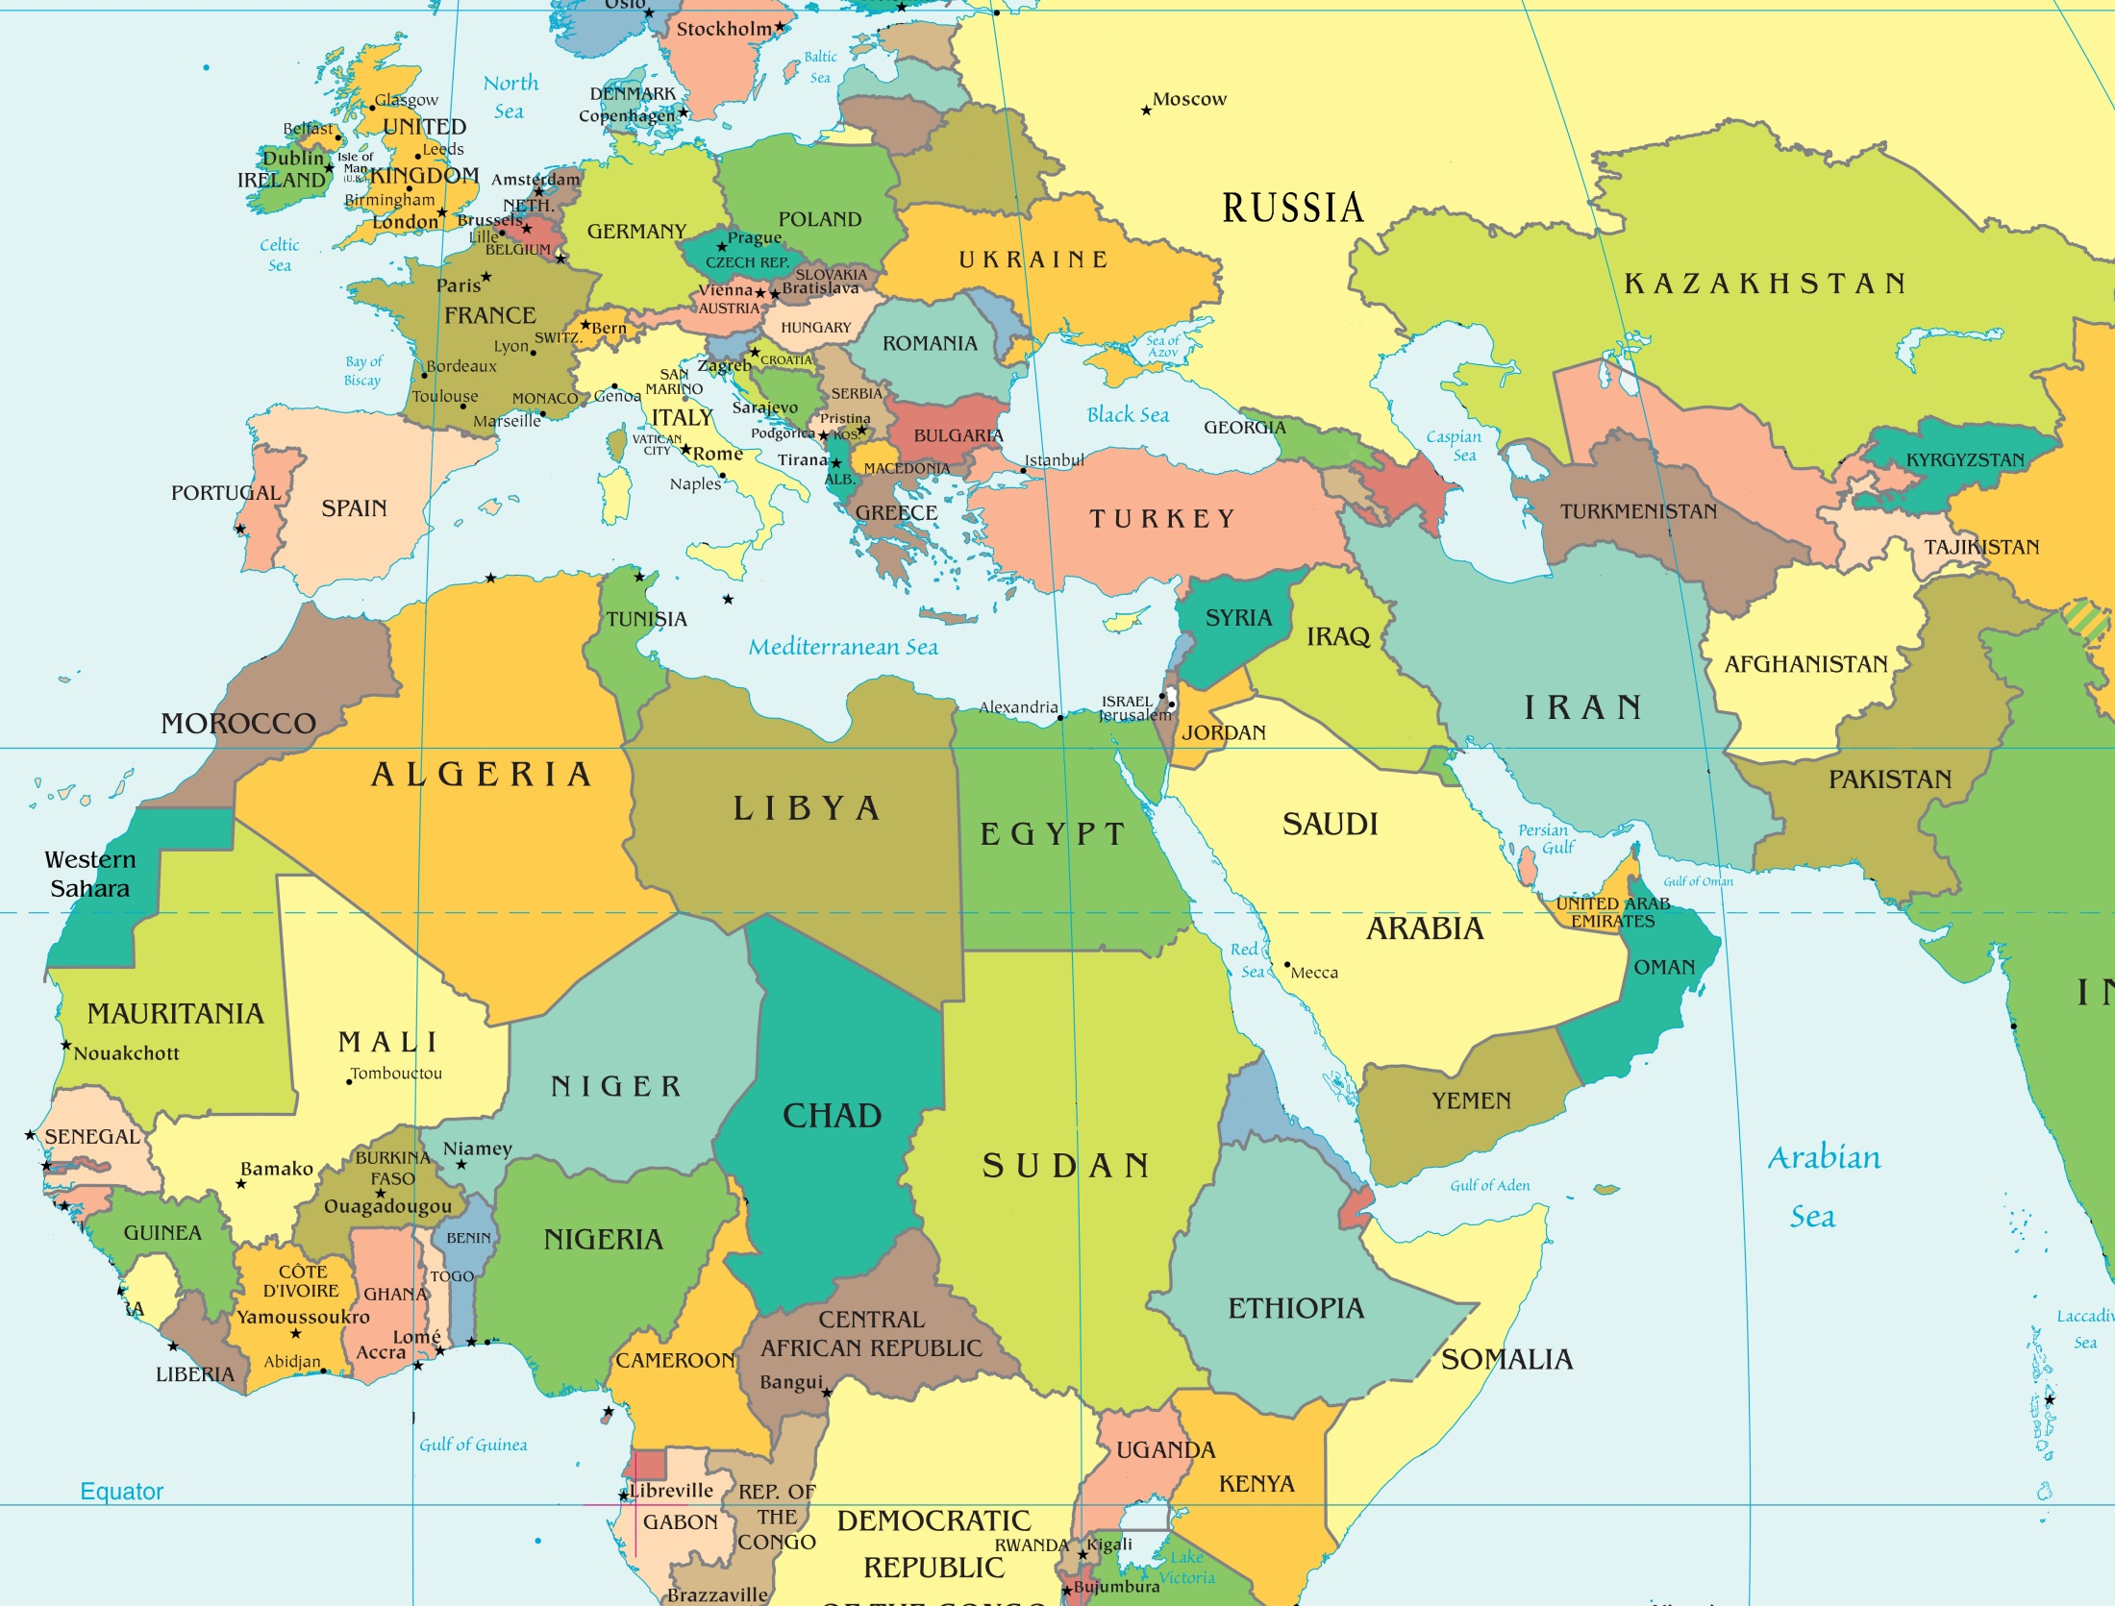
Gog
Magog(land of Gog)
Prince of Rosh
Young lions thereof
British Commonwealth
Ezekiel 38 and 39
Psalm 83 and Daniel 11:40-45
Russian led Muslim Invasion
Merchants
of Tarshish
Meshech
Tubal
Togarmah
Gomer
King of the North
Gog
Magog
(land of Gog)
Tyre
Ishmealites
Edom
Esau
Persia
King of
the South
Libya/Put
Sheba and Dedan
Southern Arabia
Ethiopia/Cush

Slide 17
Ezekiel 38 and 39
Psalm 83 and Daniel 11:40-45
When?
Battle of Gog and Magog takes place in the Tribulation making a way for the Anti-Christ to become the World power
Gog and Magog

Slide 18
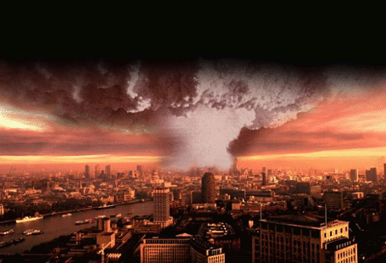
NUCLEAR WAR
Ezekiel 38:22-23 And I will plead against him with pestilence and with blood; and I will rain upon him, and upon his bands, and upon the many people that are with him, an overflowing rain, and great hailstones, fire, and brimstone.
Thus will I magnify myself, and sanctify myself; and I
will be known in the eyes of many nations, and they shall know that I am the LORD.
Zechariah 14:11-12 And men shall dwell in it, and there shall be no more utter destruction; but Jerusalem shall be safely inhabited.
12 And this shall be the plague wherewith the LORD will smite all the people that have fought against Jerusalem; Their flesh shall consume away while they stand upon their feet, and their eyes shall consume away in their holes, and their tongue shall consume away in their mouth.

Slide 19
WHAT TO DO?
Luke 21:20 And when ye shall see Jerusalem compassed with armies, then know that the desolation thereof is nigh
2 Peter 3:11-12 Seeing then that all these things shall be dissolved, what manner of persons ought ye to be in all holy conversation and godliness,
12 Looking for and hasting unto the coming of the day of God, wherein the heavens being on fire shall be dissolved, and the elements shall melt with fervent heat?

