Slide 1
MUSIC
in God’s Word

Slide 2
MUSIC
in God’s Word

Slide 3
Ecclesiastes 7:4-5
The heart of the wise is in the house of mourning; but the heart of fools is in the house of mirth.
⁵ It is better to hear the rebuke of the wise, than for a man to hear the song of fools.
Ecclesiastes 7:4-5
Notes:
One Study that we found absolutely amazed us!

Slide 4
2 Timothy 2:15
Study to show thyself approved unto God…
1 Thessalonians 5:21
Prove all things; …
2 Timothy 2:15
Notes:
One Study that we found absolutely amazed us!

Slide 5
Ephesians 5:18-19
And be not drunk with wine, wherein is excess; but be filled with the Spirit;
¹⁹ Speaking to yourselves in psalms and hymns and spiritual songs, singing and making melody in your heart to the Lord;
Ephesians 5:18-19
Notes:
One Study that we found absolutely amazed us!

Slide 6
MUSIC
Muse - ic
Root word for think or meditate
Psalm 39:3; 143:5; Luke 3:15
Music is one of God’s methods of TEACHING
Ephesians 5:19 Colossians 3:16

Slide 7
Colossians 3:16
Let the word of Christ dwell in you richly in all wisdom; teaching and admonishing one another in psalms and hymns and spiritual songs, singing with grace in your hearts to the Lord.
When the song is done playing - -
WHAT WERE YOU TAUGHT?
Colossians 3:16
Notes:
One Study that we found absolutely amazed us!

Slide 8
Genesis 4:19-24
And Lamech took unto him two wives: the name of the one was Adah, and the name of the other Zillah.
²⁰ And Adah bare Jabal: he was the father of such as dwell in tents, and of such as have cattle.
²¹ And his brother's name was Jubal: he was the father of all such as handle the harp and organ.
²² And Zillah, she also bare Tubal-cain, an instructer of every artificer in brass and iron: and the sister of Tubal-cain was Naamah.
²³ And Lamech said unto his wives, Adah and Zillah, Hear my voice; ye wives of Lamech, hearken unto my speech: for I have slain a man to my wounding, and a young man to my hurt.
²⁴ If Cain shall be avenged sevenfold, truly Lamech seventy and sevenfold.
Genesis 4
Notes:
One Study that we found absolutely amazed us!

Slide 9
Exodus 32:19-25
Since the fall of man in the Garden of Eden
There has been a music of tension and conflict
There has been a music that encourages immorality
Exodus 32:19-25
Notes:
One Study that we found absolutely amazed us!

Slide 10
The Baptist Voice – Fall 2019 Issue 33
Simple disagreements on FORM have hindered our praise
Questions and concerns about FORM constantly arise
Our Praise Is Offered To God
Jesus Makes Our Praise Acceptable
It’s not the song selection, the instrumentation, the form or structure
That make our praise acceptable. Our praise is acceptable to God
Because of Jesus’ finished work of salvation.
Our Blessings Are Abundant
Can we truly allow our praise to be hindered when God has so
Abundantly blessed us?

Slide 11
The Baptist Voice – Fall 2019 Issue 33
Simple disagreements on FORM have hindered our praise
Our Praise Is Offered To God
Jesus Makes Our Praise Acceptable
Our Blessings Are Abundant
If God is our audience and Jesus is our mediator, then the only hindrances to our praise today are the intentions and attention of our hearts.
Right and Wrong and no longer determined by obedience to God’s word - - - -
The only thing that matters are your motives.
The End Justifies The Means?

Slide 12
MUSIC
in God’s Word

Slide 13
“Lukewarmness” results in blindness.
Can a child of God
become blind?
Peter, addressing believers . . .
2 Peter 1:1-8
Blind?
Not without sight…
but rather,
without clear vision.
Literally, “surrounded by smoke.”
But he that lacketh these things
is blind, and cannot see afar off,
and hath forgotten that he was
purged from his old sins.
2 Peter 1: 9
Next topic Peter addresses . . .
. . . even denying the Lord
that bought them . . .
2 Peter 2: 1
Denial…

Slide 14
Genesis 1:1-3
In the beginning God created the heaven and the earth. And the earth was without form, and void; and darkness was upon the face of the deep.
Genesis 1:1-3

Slide 15
Genesis 1:1-3
And the Spirit of God moved upon the face of the waters. And God said, (God sounded) Let there be light: and there was light.
said
Genesis 1:1-3

Slide 16
How did God create the world?
And God said
God Created the World
Through SOUND
By the word of the
Lord were the heavens
made; and all the host
of them by the breath
of his mouth.
Psalm 33: 6
For he spake,
and it was done;
he commanded,
and it stood fast.
Psalm 33: 9
. . . the worlds were
framed by the
word of God . . .
Hebrews 11:3

Slide 17
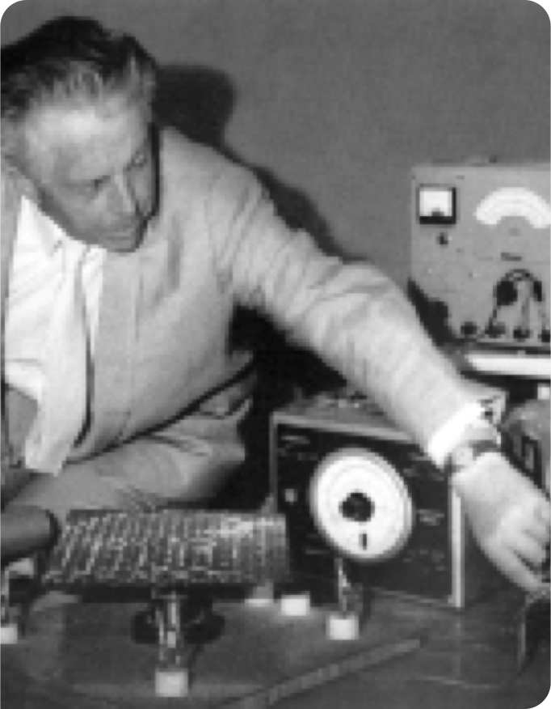
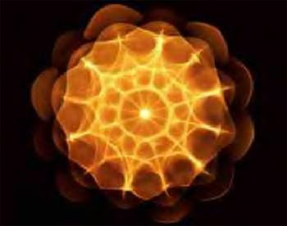
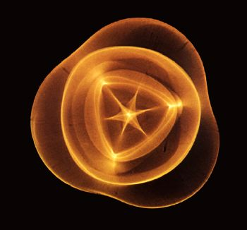
Dr. Hans Jenny
Notes:
Swiss physician and natural scientist, photographed plastics, powders, liquids, and other inorganic substances as they were being vibrated with sound. He found that inorganic matter changes shape, and forms geometric patterns that can come to resemble living creatures such as starfish and human cells. Sound moves matter!

Slide 18
Dr. Hans Jenny
“Sound has a direct influence on our human biology and thus influences our health.”
Notes:
Interesting! But we'll come back to that.
Now...

Slide 19
Notes:
When God spoke, when He sounded, He created beauty, harmony, radiance, structure, symmetry.

Slide 20
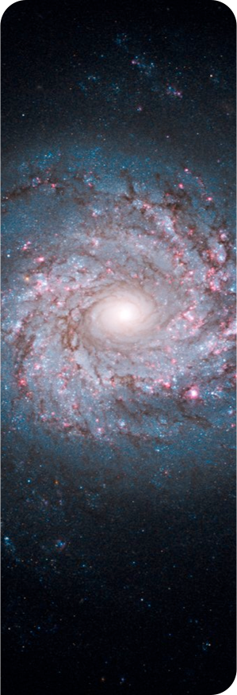
Perfect Harmony
until...
No note of discord to mar the celestial
harmonies
One chose to pervert the freedom God granted
Sin originated with Lucifer – God’s Song Leader

Slide 21
Perfect Harmony
until...
Lucifer–Son of the Morning, Chief Covering Cherub, holy and undefiled
Indulged the desire for self-exaltation
Ventured to covet the homage due alone to Christ
Now the perfect harmony of Heaven was broken

Slide 22
25

Slide 23
1 Peter 5:8
“Be sober, be vigilant; because your adversary the devil, as a roaring lion, walketh about, seeking whom he may devour.”
1 Peter 5:8
Notes:
There are so many ways the enemy is accomplishing his purposes today. He is sly and deceitful.
Looking around at our world most of us will agree that there is a vast playground of sin that he has cleverly packaged to try and trip us up. Music is one of the things that he has so cleverly perverted and deceitfully packaged.

Slide 24
The great Adversary–Satan
The twofold work of Satan is
Deception and Accusation
Revelation 12:9-10 And the great dragon was cast out, that old serpent, called the Devil, and Satan, which deceiveth the whole world: he was cast out into the earth, and his angels were cast out with him.
10 And I heard a loud voice saying in heaven, Now is come salvation, and strength, and the kingdom of our God, and the power of his Christ: for the accuser of our brethren is cast down, which accused them before our God day and night.
Notes:
If deception is the major work of Satan
And Satan knows music because of how God created him
Then what would be Satan’s main tool for Deception

Slide 25
Ezekiel 28
12 Son of man, take up a lamentation upon the king of Tyrus, and say unto him, Thus saith the Lord God; Thou sealest up the sum, full of wisdom, and perfect in beauty.
13 Thou hast been in Eden the garden of God; every precious stone was thy covering, the sardius, topaz, and the diamond, the beryl, the onyx, and the jasper, the sapphire, the emerald, and the carbuncle, and gold: the workmanship of thy tabrets and of thy pipes was prepared in thee in the day that thou wast created.
14 Thou art the anointed cherub that covereth; and I have set thee so: thou wast upon the holy mountain of God; thou hast walked up and down in the midst of the stones of fire.
15 Thou wast perfect in thy ways from the day that thou wast created, till iniquity was found in thee.
EZEKIEL 28:12-15

Slide 26
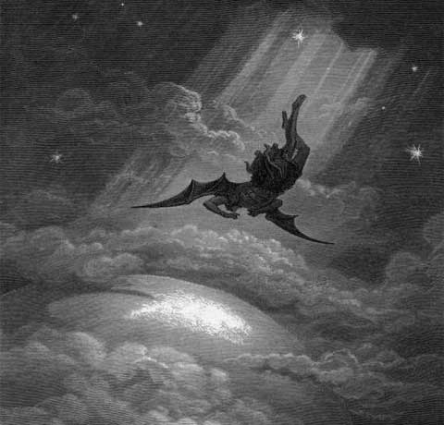
Revelation 12:7&9
“There was war in Heaven. And the great dragon was cast out, that old serpent, called the Devil, and Satan, which deceiveth the whole world:
Revelation 12:7&9

Slide 27
Revelation 12:9
he was cast out into the earth, and his angels were cast out with him.
Revelation 12:9

Slide 28
Zephaniah 3:17
Music is of a Heavenly Origin...
“The LORD thy God…
will joy over thee with singing.”
Zephaniah 3:17

Slide 29
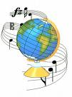
God’s Creation Is Musical
Isaiah 35:1, 2; 49:13
Heavens, Earth, Desert, Corn, Mountains…Sing
Psalm 65:13
Flocks & Corn Sing
Psalm 104:12
Fowls Sing
Job 38:7
The Stars Sing
Isaiah 44:23
Heavens Sing
Isaiah 14:7
The whole earth is at rest, and is
quiet, they break forth into singing.

Slide 30
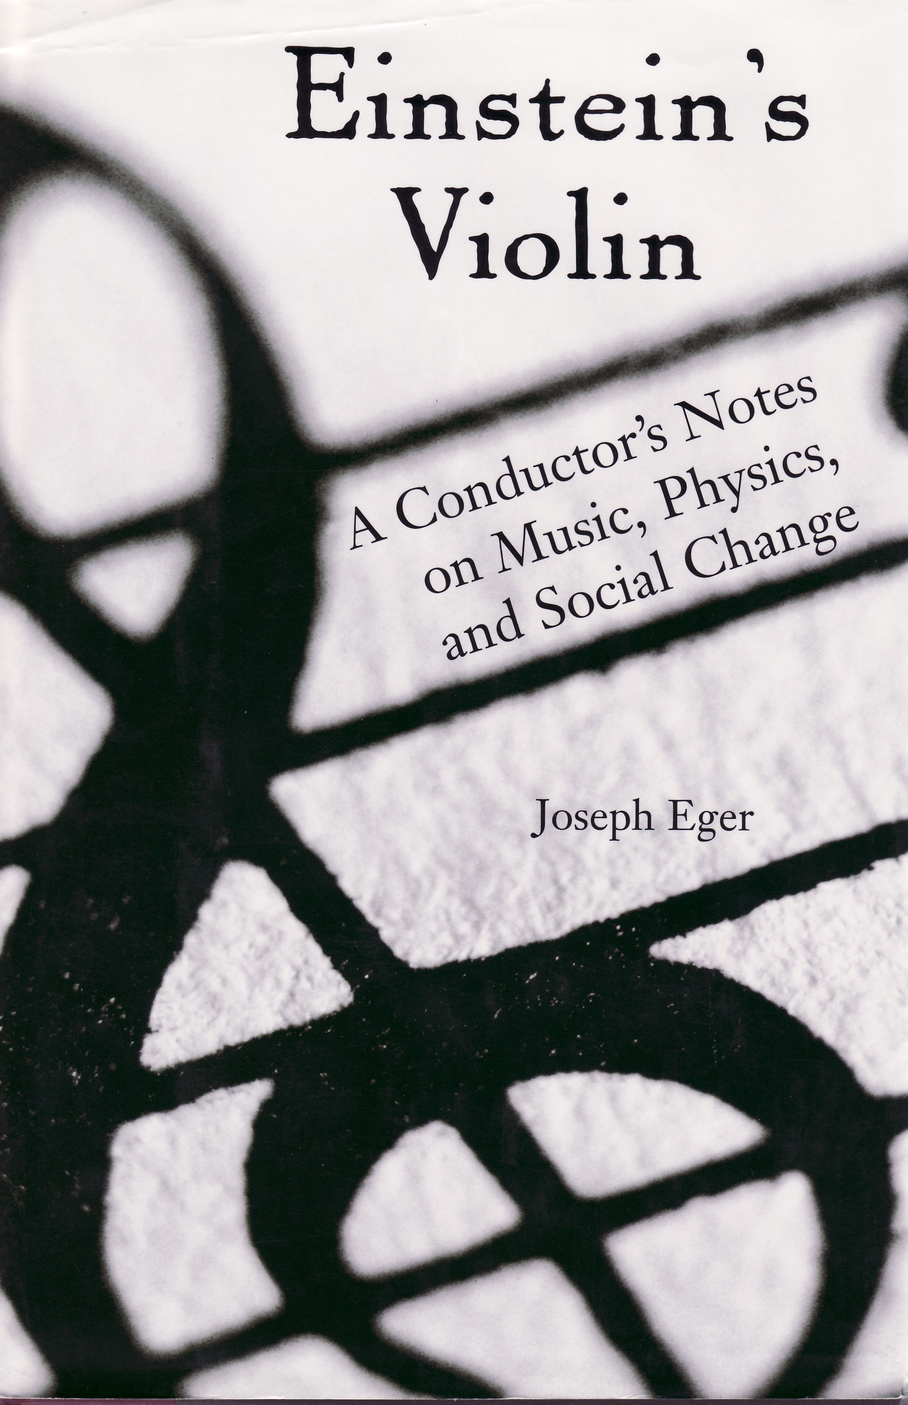
God’s Creation Makes Music!
Einstein’s Violin
A Conductor’s Notes on Music,
Physics, and Social Change
Joseph Eger
The
STARS
“Basically, each planet creates
vibrations—sound waves—caused
by the path of its traveling through space. Therefore, each planet produces music
that stems directly from the speed
of its motion in orbit.” (p. 172)
SING!

Slide 31
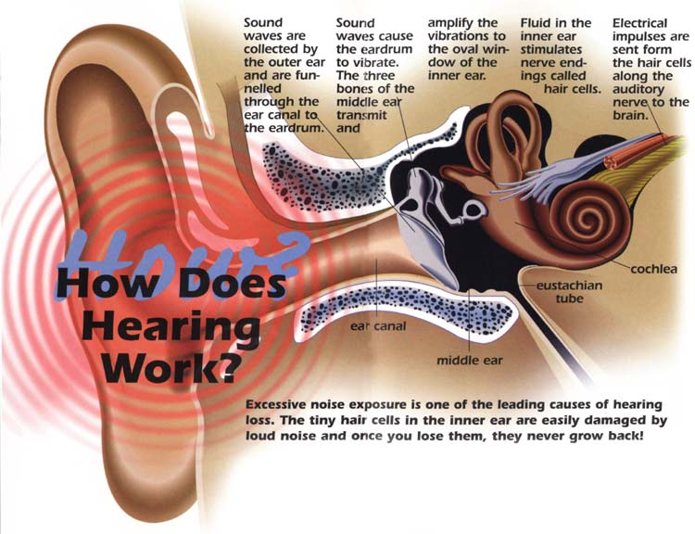
THE IMPORTANCE of HEARING
Scripture mentions
hearing and the ear
approximately 1,500 times.
Mt. 13:16 Pr. 1:8 Heb. 2:1
Pr. 15:31 Pr. 19:20

Slide 32
Tone Deaf & All Thumbs? Frank R. Wilson Professor of Neurology - Practicing Neurologist
Our ears respond to...
19,985 individually
perceptible
sound frequencies.
Our eyes respond to...
375 individually perceptible
wavelengths of light. (p. 149)
Conclusion?
Our ears are over 50 times
more sensitive than our eyes!

Slide 33
Proverbs 4: 23
Keep thy heart with all diligence;
for out of it are the issues of life.
Guard Your Heart
Literally…
Where do we place guards?
Entrances
What are the entrances
to our heart?
Eyes & Ears
Hearing & Seeing
... for out of the abundance of the heart
the mouth speaketh.
(Mt. 12: 34 Lk. 6: 45)

Slide 34
THE IMPORTANCE of HEARING
Romans 10:17 So then faith cometh…
Faith
Hearing
The Word of God
The Word Plus Hearing Results in Faith

Slide 35
The Importance of Hearing
Faith
“Hearken”
Hearing
“Hearken”
“Hearken”
Joy and Gladness
Thanksgiving
“Voice of Melody”
MUSIC
The Word of God
Listening to God and Building Our Faith
Involves Music

Slide 36
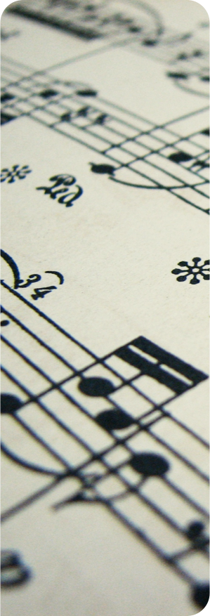
Music Is Very Powerful
God Created Music (John 1:1-3; Col. 1:16-18; Rev. 4:11)
He loves music
He Himself sings (Zeph. 3:17)
He knows how music can move and affect us (1 Samuel 16:23)
When used properly (Exodus 32:6-8 & 17-18)
Notes:
END :When used properly- it can draw us closer to Him helping us to live in harmony with Him. When wrongly used it can bring disharmony in our relationship and can become a distraction. This creates a dilemma for the Christian.

Slide 37
And it came to pass, when the evil spirit from God was upon Saul, that David took an harp, and played with his hand: so Saul was refreshed, and was well, and the evil spirit departed from him.
Music Affects
You 3 ways
Mentally
Physically
Spiritually
1 Samuel 16:23

Slide 38
MUSIC has the power to control your moods
2 Kings 3:14-15
Notes:
That's awesome!

Slide 39
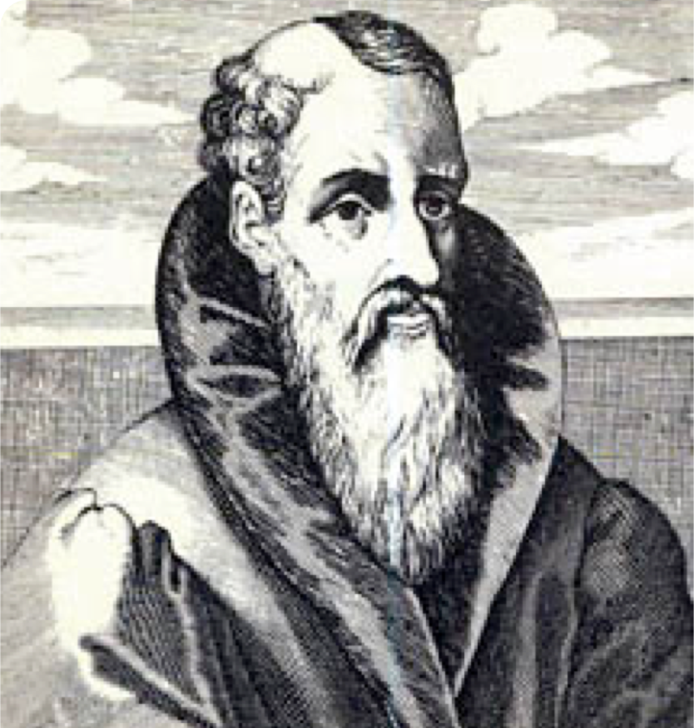
6th Century, Roman philosopher Anicius Boethius, wrote:
"Music can both establish and destroy morality. For no path is more open to the soul for the formation thereof than through the ears.

Slide 40
Therefore when the rhythms and modes have penetrated even to the soul through these organs, it cannot be doubted that they affect the soul with their own character and conform it to themselves."

Slide 41
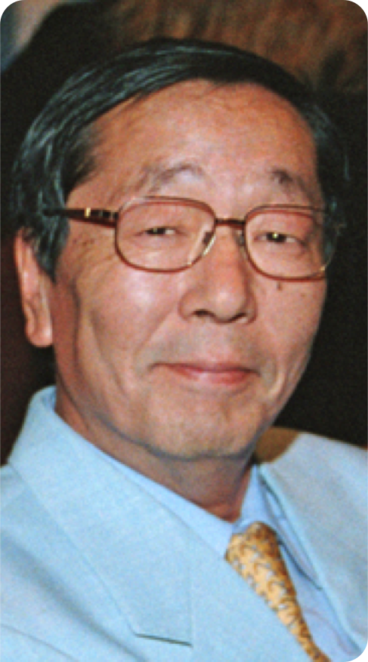
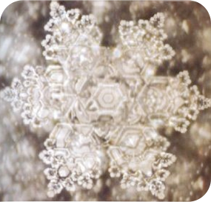
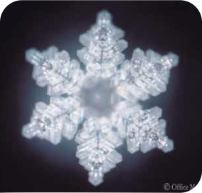
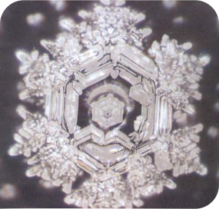
Masaru Emoto
Beautiful music and words form crystalline structures from water molecules.
Notes:
He played music while the water froze

Slide 42
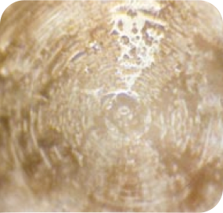
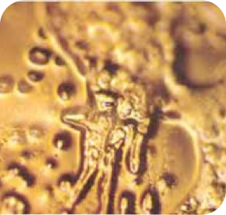
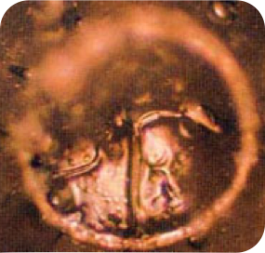
Masaru Emoto
Discordant tones and negative music form chaotic patterns every time.

Slide 43
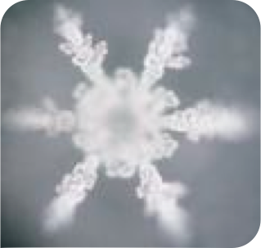
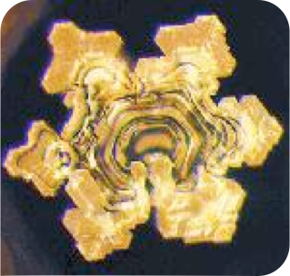
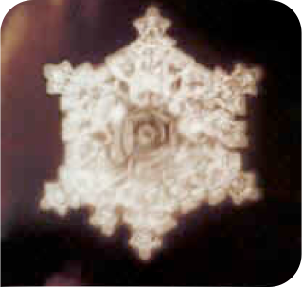
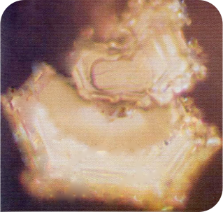
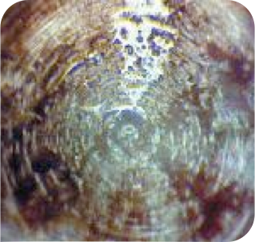
Tchaikovsky
Swan Lake
Mozart
Symphony No.40
Beethoven
Pastoral
Elvis
Heartbreak Hotel
Heavy Metal
Notes:
The implication of this research is tremendous in light of music and its effects on our bodies, mind and soul. Science has proven that since our bodies are 90% water we are actually physically affected by the sounds, words and music that enter our bodies. Every cell in our body has a frequency and systems have harmonies the systems in our bodies and mind can be supported and even assisted or hindered and negatively altered by the sounds and the music experience. Which sound would be better?

Slide 44
Proverbs 2:1-5
“My son, if thou wilt receive my words, and hide my commandments with thee; So that thou incline thine ear unto wisdom, and apply thine heart to understanding;…
Proverbs 2:1-5

Slide 45
Proverbs 2:1-5
then shalt thou understand the fear of the Lord, and find the knowledge of God.”
Proverbs 2:1-5
Notes:
We are going to use inspired words, science, the words of professionals and the Bible to examine music.

