Slide 1
“First Movement:
Music History 450AD-1969”
Pt2
Notes:
As we dive into these music samples it is important and profitable to realize that music was designed by God to serve a purpose.

Slide 2
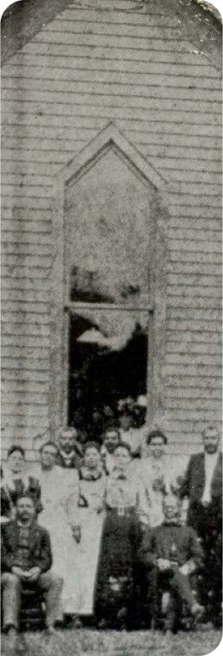
In the 1840’s
A lot of Africans started turning to Christ and were allowed to have their own churches
Some turned away from drums completely, others incorporated them into their new faith

Slide 3
In the 1840’s
They would sing the same hymns as the caucasians but with shouting and beating out counter rhythms on tambourines, gourds and logs
Eventually bringing about the holy flesh movement
Congregants still sought for possession only now it was called the
“Holy Ghost”
Notes:
Speak in tongues, Flip around on ground, same as pagan worshippers, using same voodoo
Baptized paganism
I don't believe these new converts were trying to bring demon possession INTO the church they just did not know any other way to worship!
We will come back to this idea

Slide 4
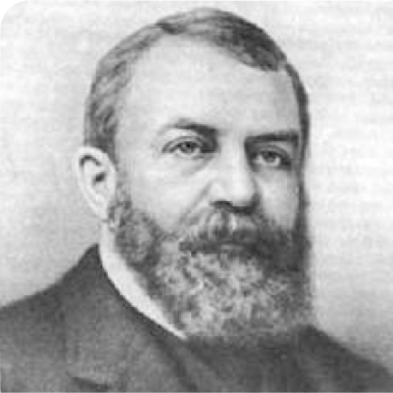
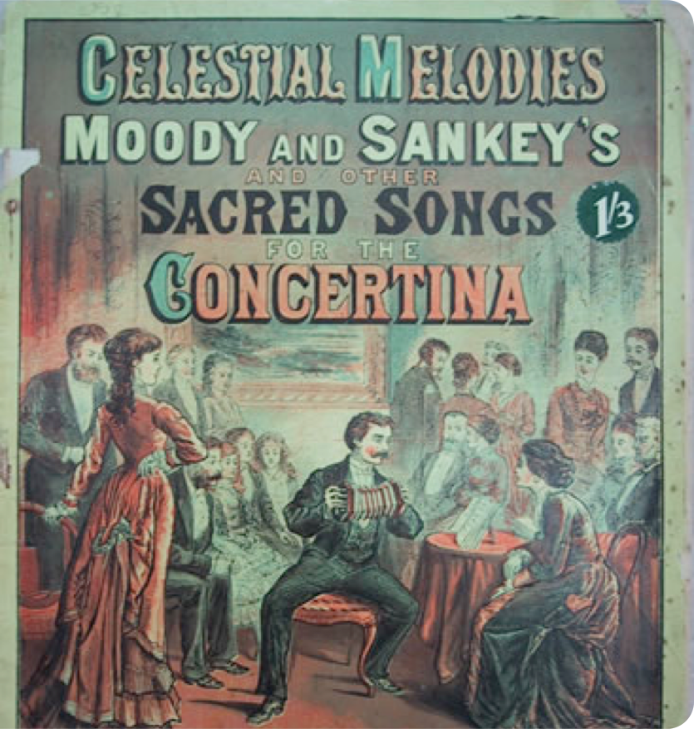
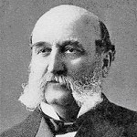
Moody & Sankey
“Amazing Grace”
Notes:
Dwight Moody & Ira Sankey 1875
Music Clip-Amazing Grace (Sacred)
CLIP-1851 Old Folks At Home (secular/America)(acceptable)
CLIP-1859 Dixie (folk/America)(note:as we continue start paying attention to how it moves body/classical-head/folk-upper torso/voo-doo-sensual lower)
beat dominately on the 1 & 3 but there is another cross rhythm coming in too that is on the 2 & 4 (remember sync good when sprinkled, problem when constant)
Traditional american music had not adopted the lower base sounds of tribal music yet but it did have strong rhythm and sincopation at times
(becomes big problem when the two really combine 50/60s)

Slide 5
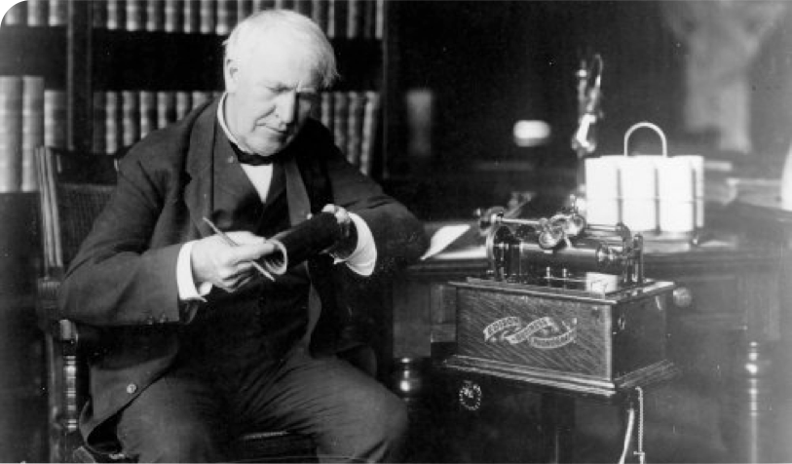
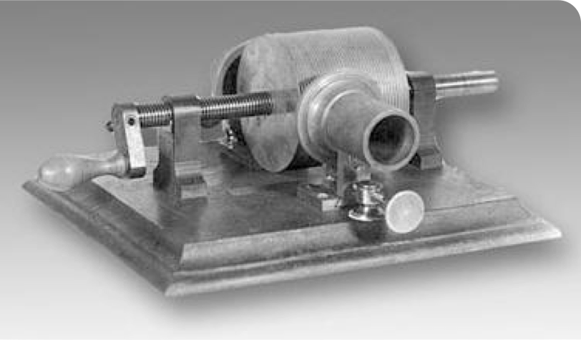
Thomas Edison invented sound recording in 1877
Notes:
This would drastically change the way we listened to music.
Up to this point had to be where music was being played!
Its influence was LIMITED.

Slide 6
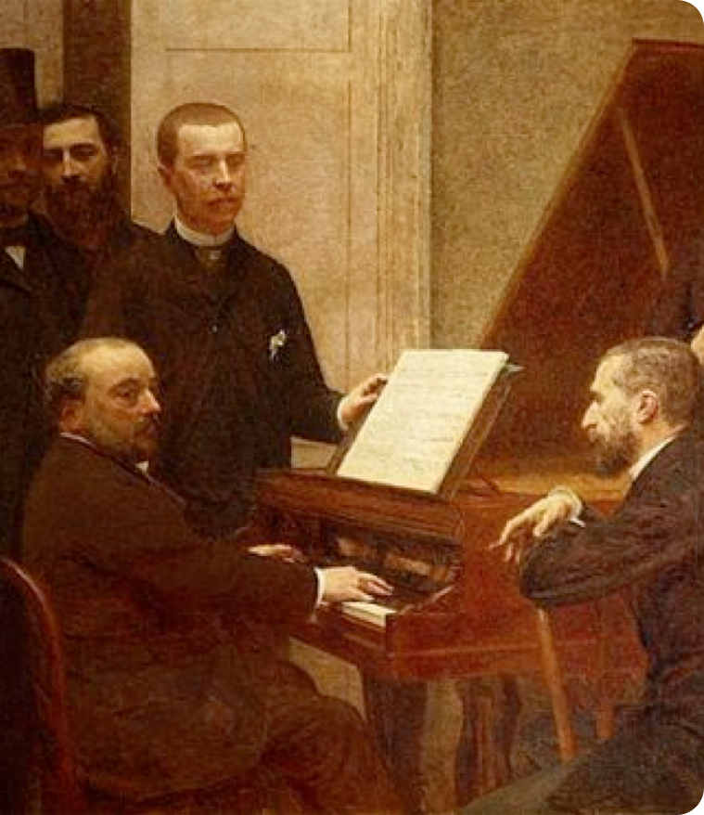
20th Century 1900-2000
Artists started using technology to enhance their compositions
Modern popular music was just coming to life, especially in America

Slide 7
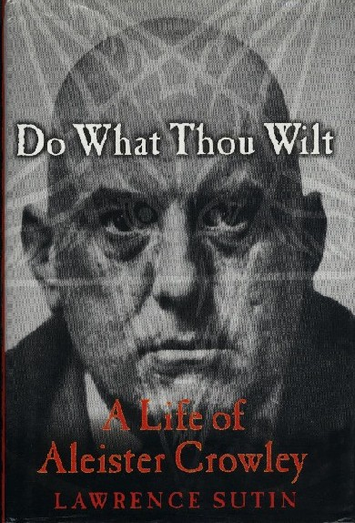
Aleister Crowley
Founded the religious philosophy of Thelema
Wrote the “Book of the Law”
States, “Do What Thou Wilt Shall Be the Whole of the Law.”
Notes:
Crowley claims that the author was an entity named Aiwass, whom he later referred to as his personal Holy Guardian Angel (or "Higher Self").

Slide 8
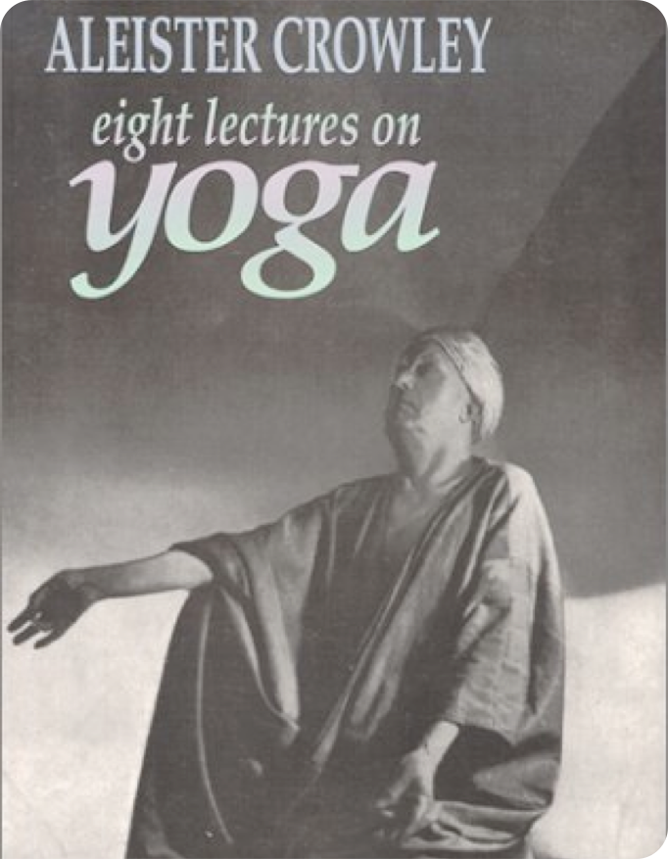
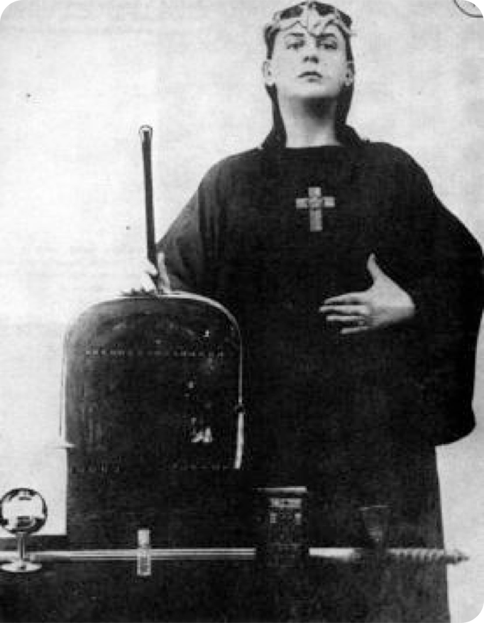
Aleister Crowley
Included in his book
Ideas from the occult, Yoga, East & Western mysticism especially Kabala

Slide 9
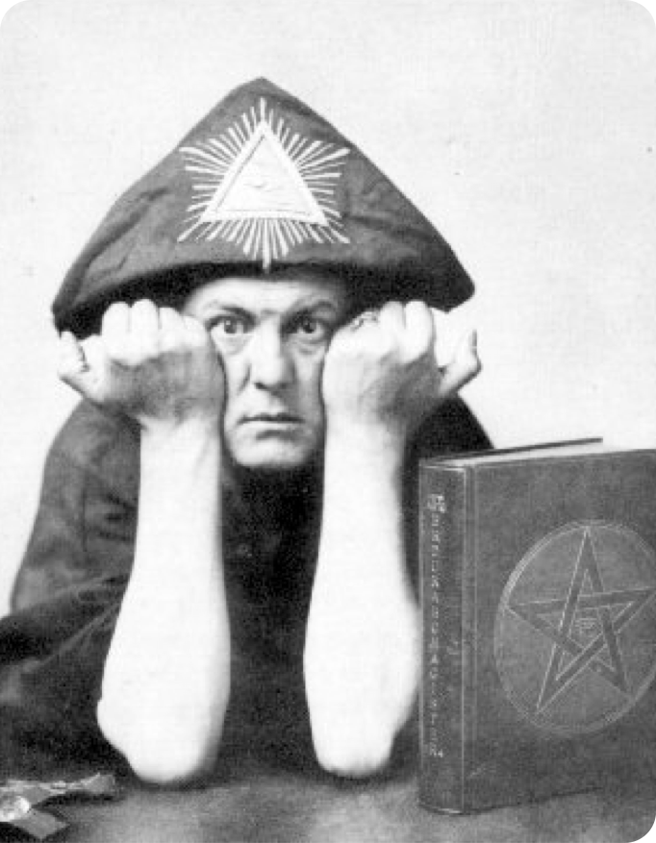
Aleister Crowley
Included in his book
Expressed views about sex that were radical
Stated he, "was in revolt against the moral and religious values of his time"

Slide 10
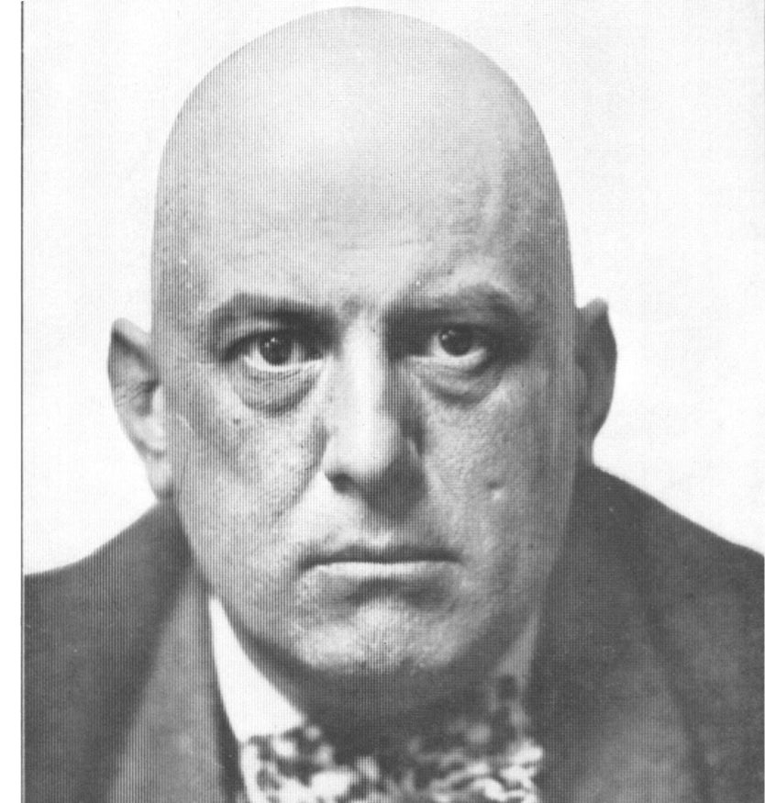
Aleister Crowley
Father of modern day Satanism
He was denounced by the popular press of his day as, “the wickedest man in the world”

Slide 11
Aleister Crowley
He desired to use music to bring on the “new age”
Desired to use “an army of youth” to indoctrinate with ‘Do What Thou Wilt’

Slide 12
Aleister Crowley
Crowley taught that one could become, “a genius in music,” through practicing his Satanism.
Notes:
He has remained an influential figure to current day

Slide 13
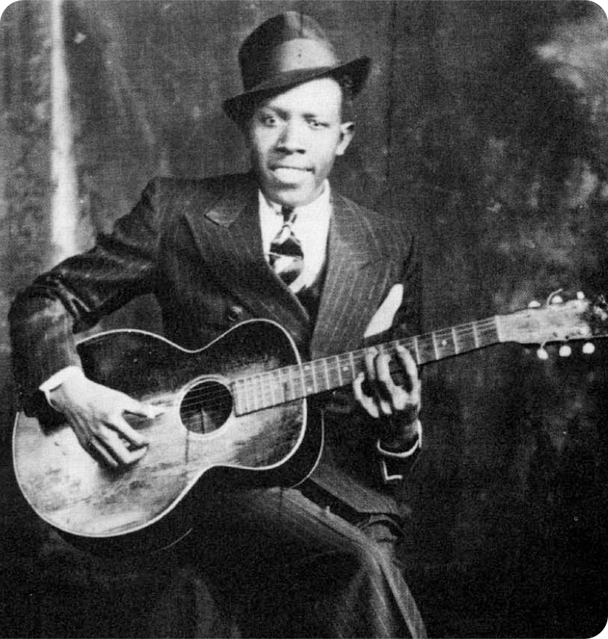
Robert Johnson
Often considered the first bluesman in the chain ultimately leading to Rock n’ Roll
Experienced what Crowley said in his life
Many of his songs refer to his personal deal he made with the Devil
Notes:
Second bullet: Tell his story
MUSIC

Slide 14
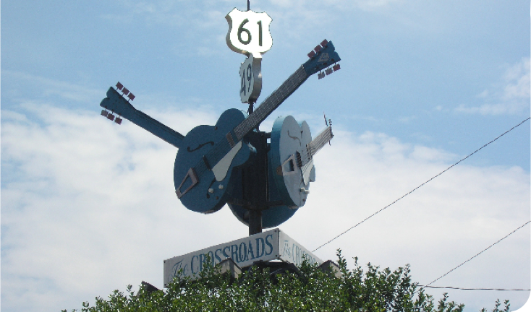
Johnson wrote...
“Everyone knows you make a deal with the devil down at the crossroads.”
He literally sold his soul to the devil for success
Friends and colleagues shared that for the balance of his life he was a tormented soul

Slide 15
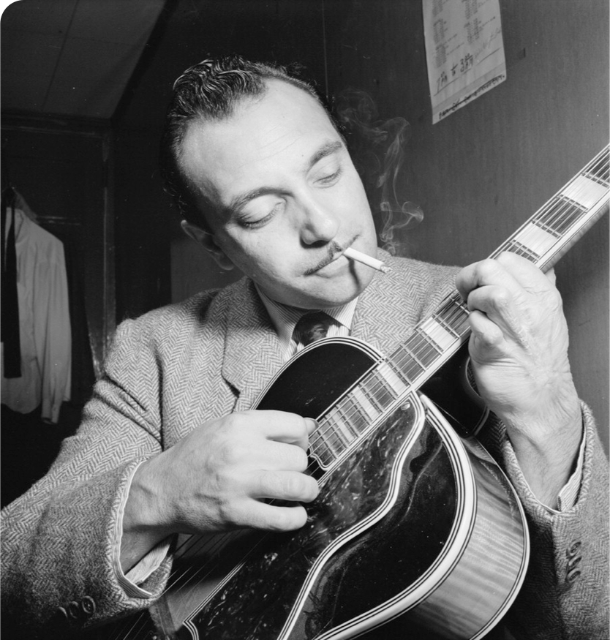
The Blues music that came out of Congo Square glorified...
drinking
womanizing
gambling
drugs
violence
depravity

Slide 16
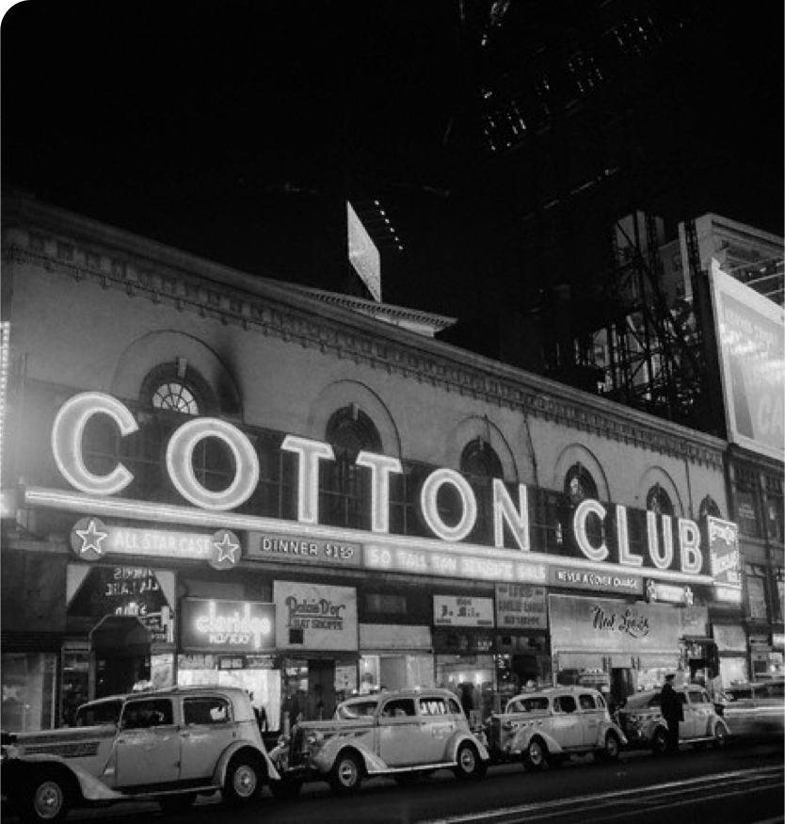
Ministers and pastors warned their congregants not to listen to it
Many heeded the warning: even some bluesman were convinced

Slide 17
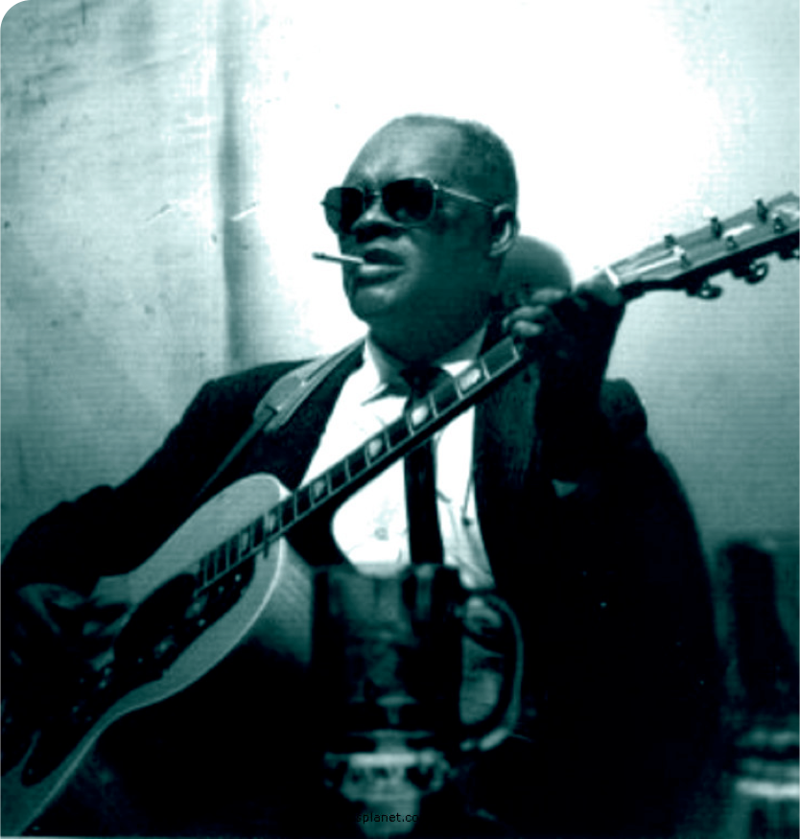
Legendary blues picker Gary Davis refused to play the blues after he was ordained as a reverend
The blues was looked upon as the devil’s music

Slide 18
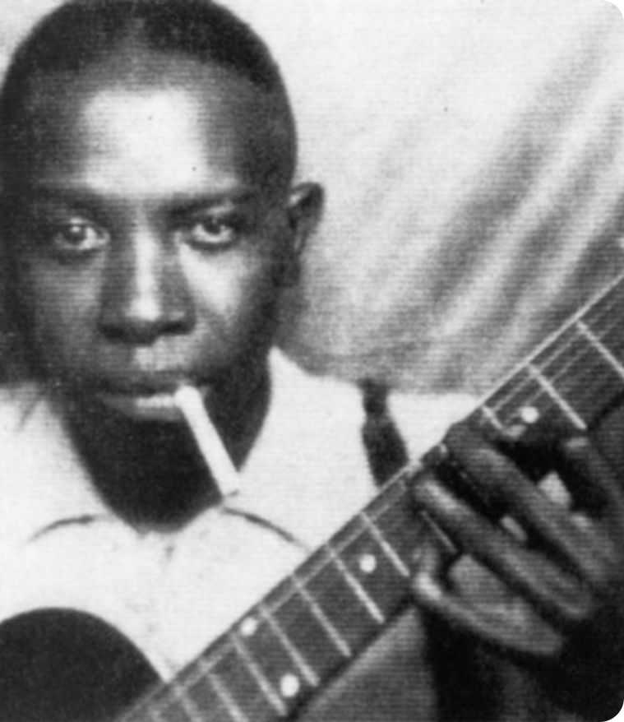
Robert Johnson
He said, referring to the blues:
“This sound, my music, did something to women that caused them to do stuff I didn’t even understand, but I liked it.”

Slide 19
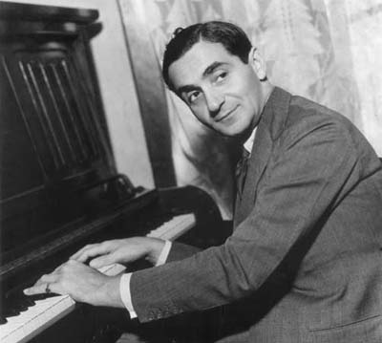
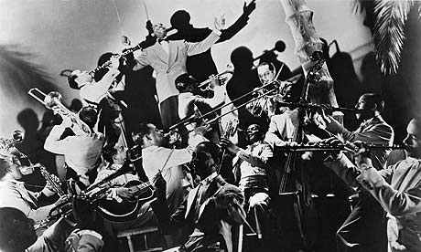
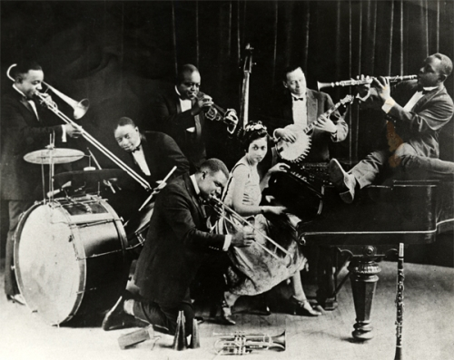
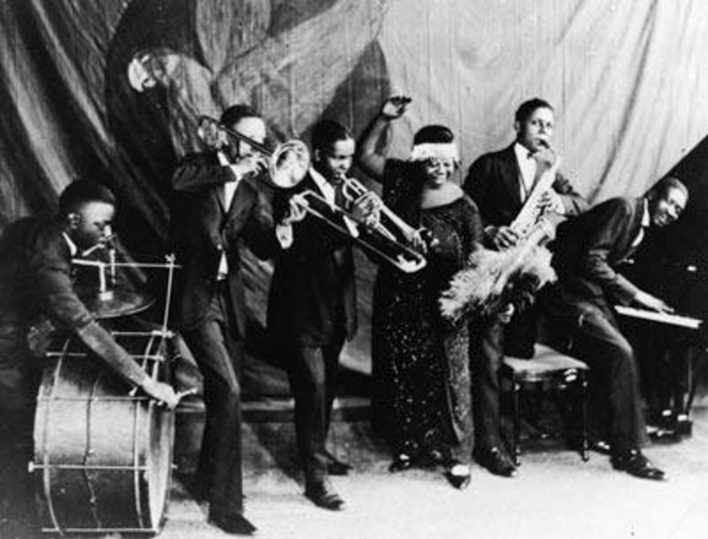
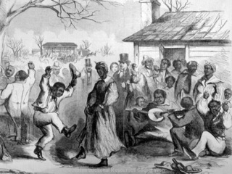
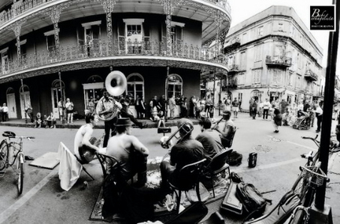
20th Century
The amorphous black folk music of the South was shaping into some of the great musical styles of the 20th century; blues and jazz
Lively tin-pan alley tradition of white pop was developed by Irving Berlin
American “pop”ular music began to spread abroad
Notes:
We are going to listen to quite a few clips right now to cover early 1900-1940 to show the progression happening.
CLIP 1: black folk music
CLIP 2: progression
CLIP 3: Jazz 1920
CLIP 4: R&B 1930
BULLET POINT THEN...
CLIP 5: 1930 Irving Berlin (start using some of the jazz elements/don’t adopt the R&B sound yet but that’s coming!)
CLIP 6: In 1940 this is what the sound of R&B had come to.
All that would be considered secular music but gospel music was becoming very popular during this time too.
Here are a few examples of top gospel songs one from the 20/30/40s
CLIP 7- 1920 The Old Gospel Ship
CLIP 8-1930 Lead Me That Rock
CLIP 9-1940 Jesus Met the Woman at the Well (Jesus talking!)(gospel jazz, makes you want to get low as opposed to lift)

Slide 20
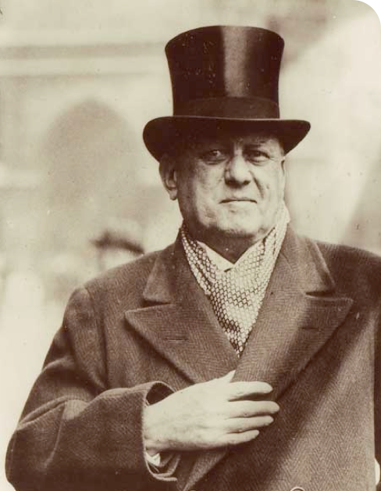
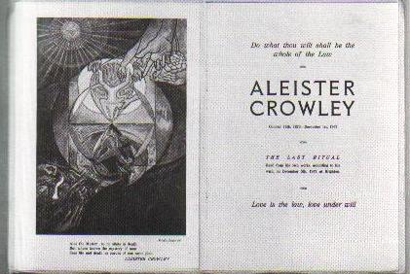
In 1947 Crowley Dies
But his Satanism lives on and becomes immortalized.

Slide 21
In 1947 Crowley Dies
His satanic philosophy, Do What Thou Wilt, combined with the accentuated, driving beats of the new music wreaks havoc on the morals of America and the world.
Notes:
But...

Slide 22
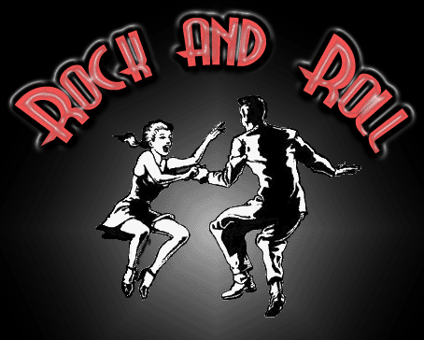
1950’s
Developed from southern Blues with a strong back beat
Notes:
When 1950’s are mentioned-1st thing comes to mind Rock n’ Roll
-Developed from southern blues with an added strong back beat
-In 1951 in an effort to introduce rhythm and blues to a broader white audience
Still hesitant to fully embrace “black music”, disc jockey...

Slide 23
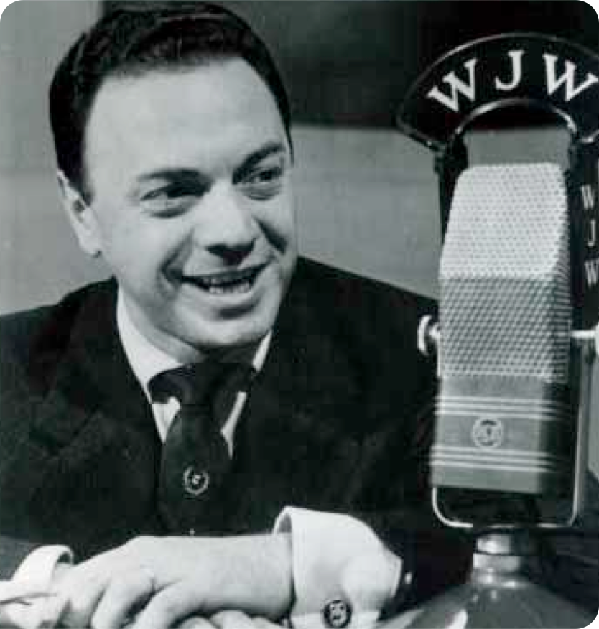
Alan Freed
Used the term "Rock n’ Roll" to describe R & B
Notes:
Gets its name from young people in the back seat

Slide 24
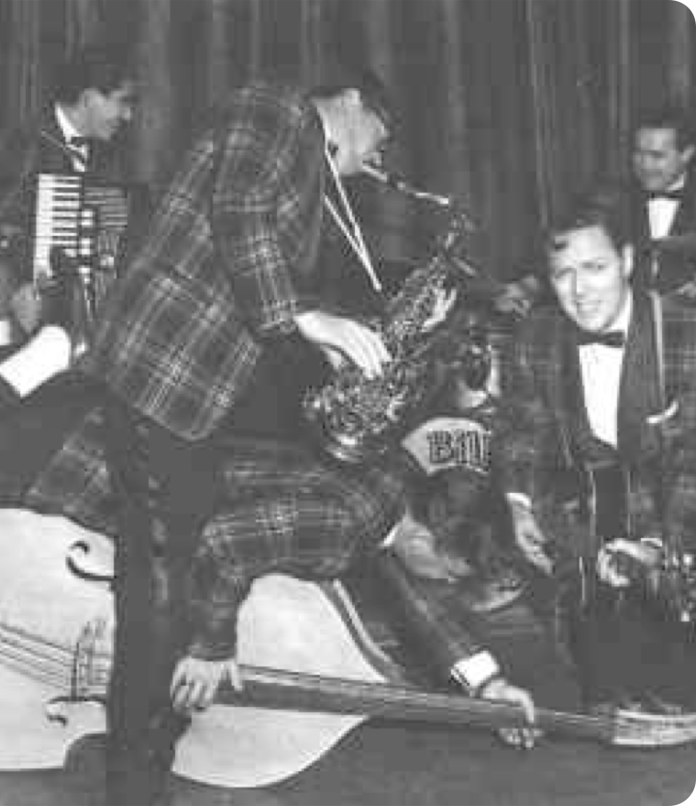
Bill Haley and the Comets
In 1954 they began writing hit songs.
As a white band using black-derived forms, they ventured into rock 'n' roll.
Notes:
Rhythm guitar (notice identical poly rhythmic elements)
Happier, fun, energetic song
MUSIC

Slide 25
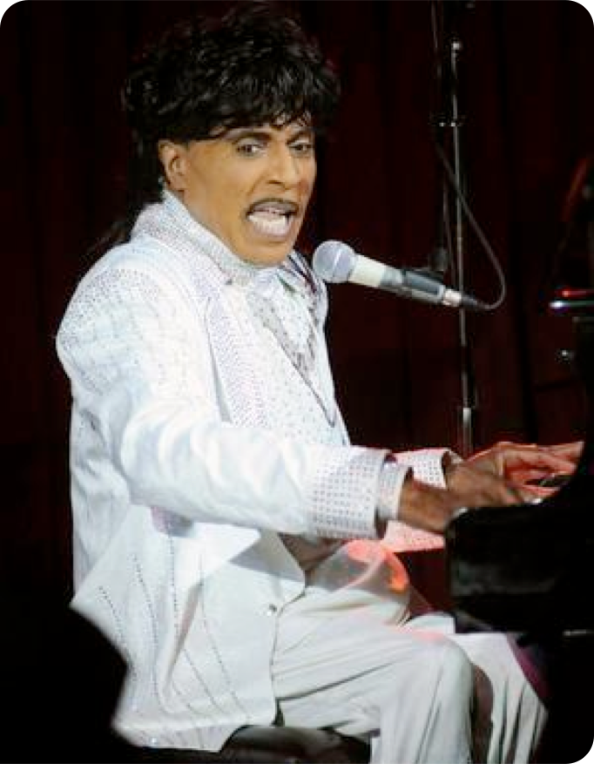
Little Richard
My true belief about Rock ‘n’ Roll, is this:
I believe this kind of music is demonic.
The Life and Times of Little Richard by Charles White p 197
Notes:
One of the earliest pioneers of Rock n' Roll said:

Slide 26
Little Richard
A lot of beats in music today are taken from Voodoo, from the Voodoo drums. If you study music in rhythms, like I have, you’ll see that this is true.”
The Life and Times of Little Richard by Charles White p 197
Notes:
In fact in a sermon on music, we heard a story of a young man who came over from Africa to attend college here in America. Not long after being here, he heard a song on the radio and went “hey, I know that rhythm, thats fom back home! I can play that! SO he went and joined the college band.
The gentleman who was telling the story told us the name of the song, “Tear Drops from My Eyes”, well we wanted to know what it was that he heard that made him think of tribal music back home. Would you?...
MUSIC CLIP- Tear Drops From My Eyes

Slide 27
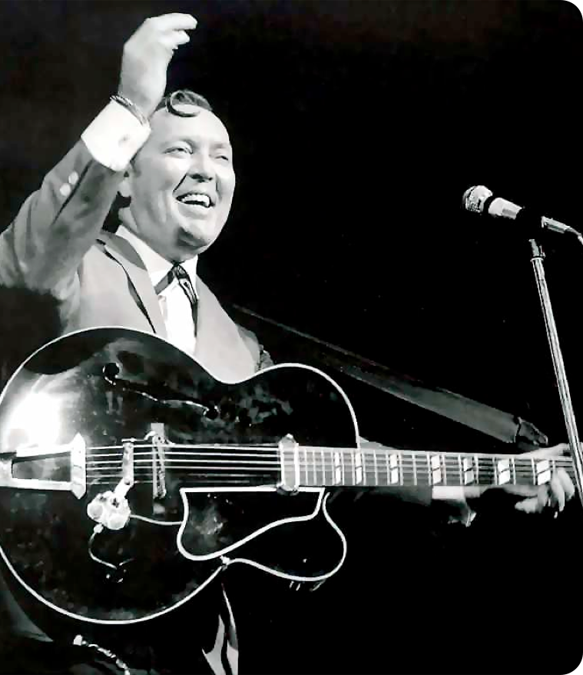
In a VH1 Rockumentary they said...
“It was through the innocent looks of Bill Haley that rock music was able to slip through the parental radar like a trojan horse.”
Notes:
The gates had been opened

Slide 28
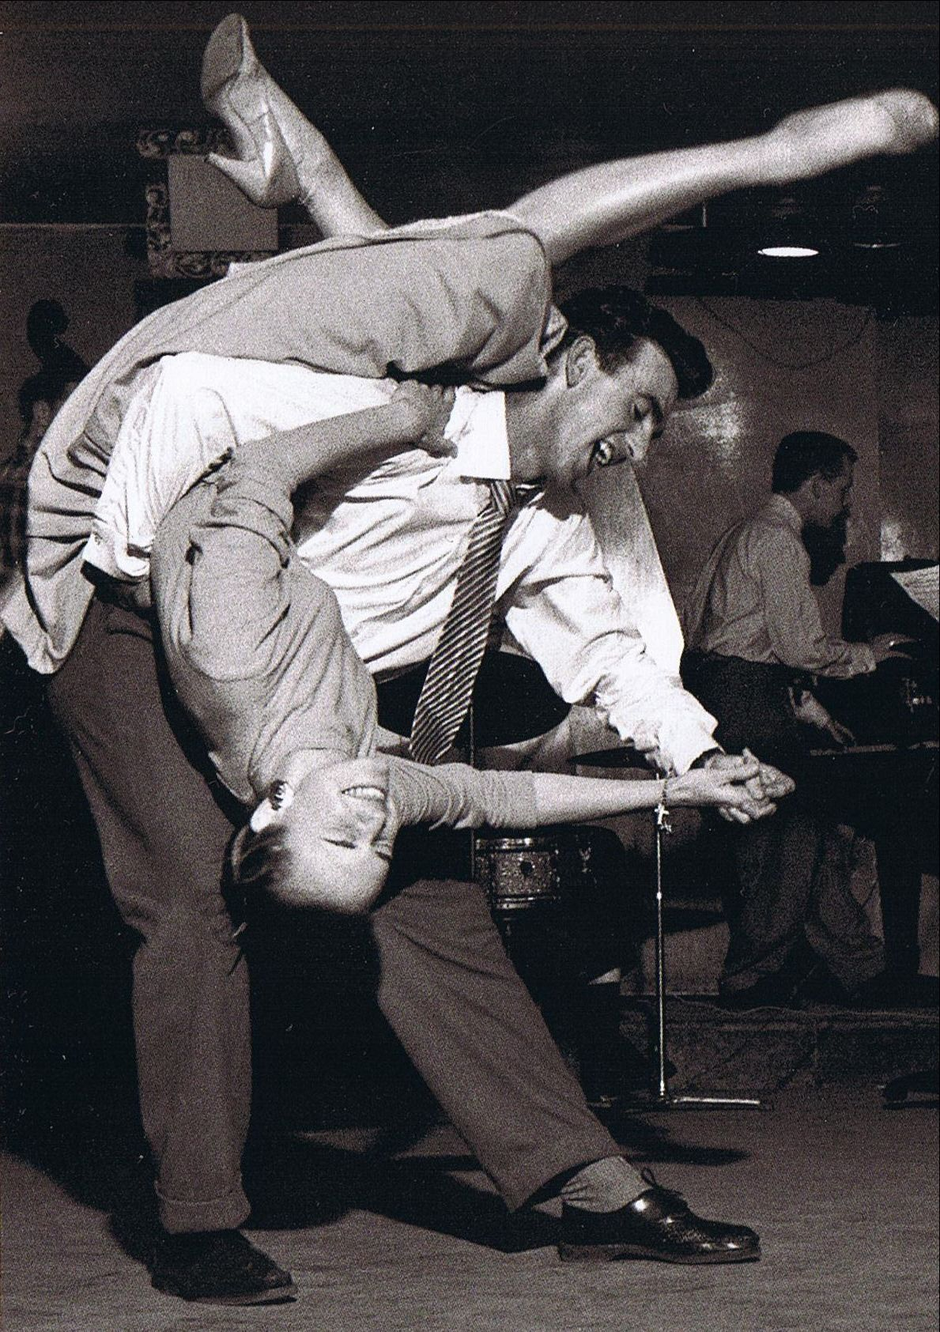
Rock was popular with teens wanting to break out of the conservative American mold.
Notes:
Before Bullet Points:
By the late 50’s rock n’ roll began showing its negative effects...
It was unmasked as...
There was a good reason for people to be concerned
The music had a licentious effect.

Slide 29
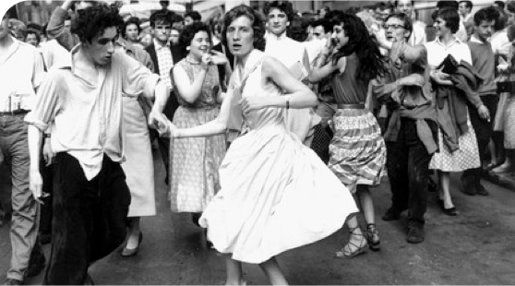
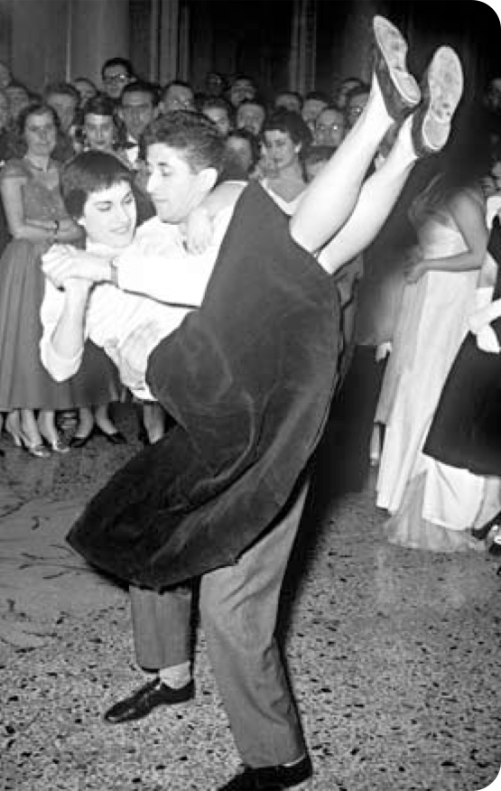
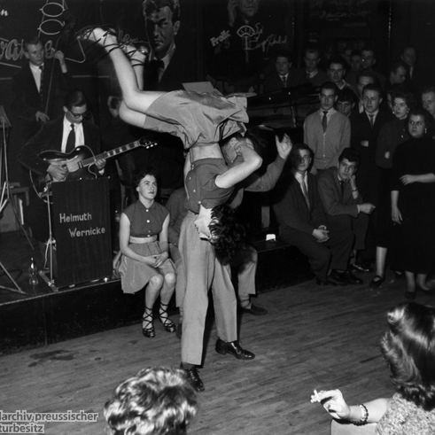
Decadent
Dangerous
Immoral
Obscene
Notes:
Before Bullet Points:
By the late 50’s rock n’ roll began showing its negative effects...
It was unmasked as...
There was a good reason for people to be concerned
The music had a licentious effect.

Slide 30
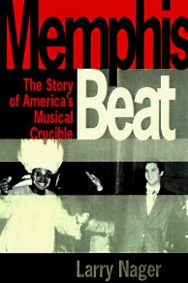
Memphis Beat
The author talks of a part of Memphis that was involved in immorality, Mill Street. This is where the houses of prostitution, the taverns and the gambling places were. He states that there was always a certain type of music at Mill St. This is what he says…

Slide 31
Memphis Beat
“The forbidden pleasures of Mill St. always, always came wrapped in the pulsing rhythms of the blues.”
Memphis Beat, Larry Nager

